Slide 1
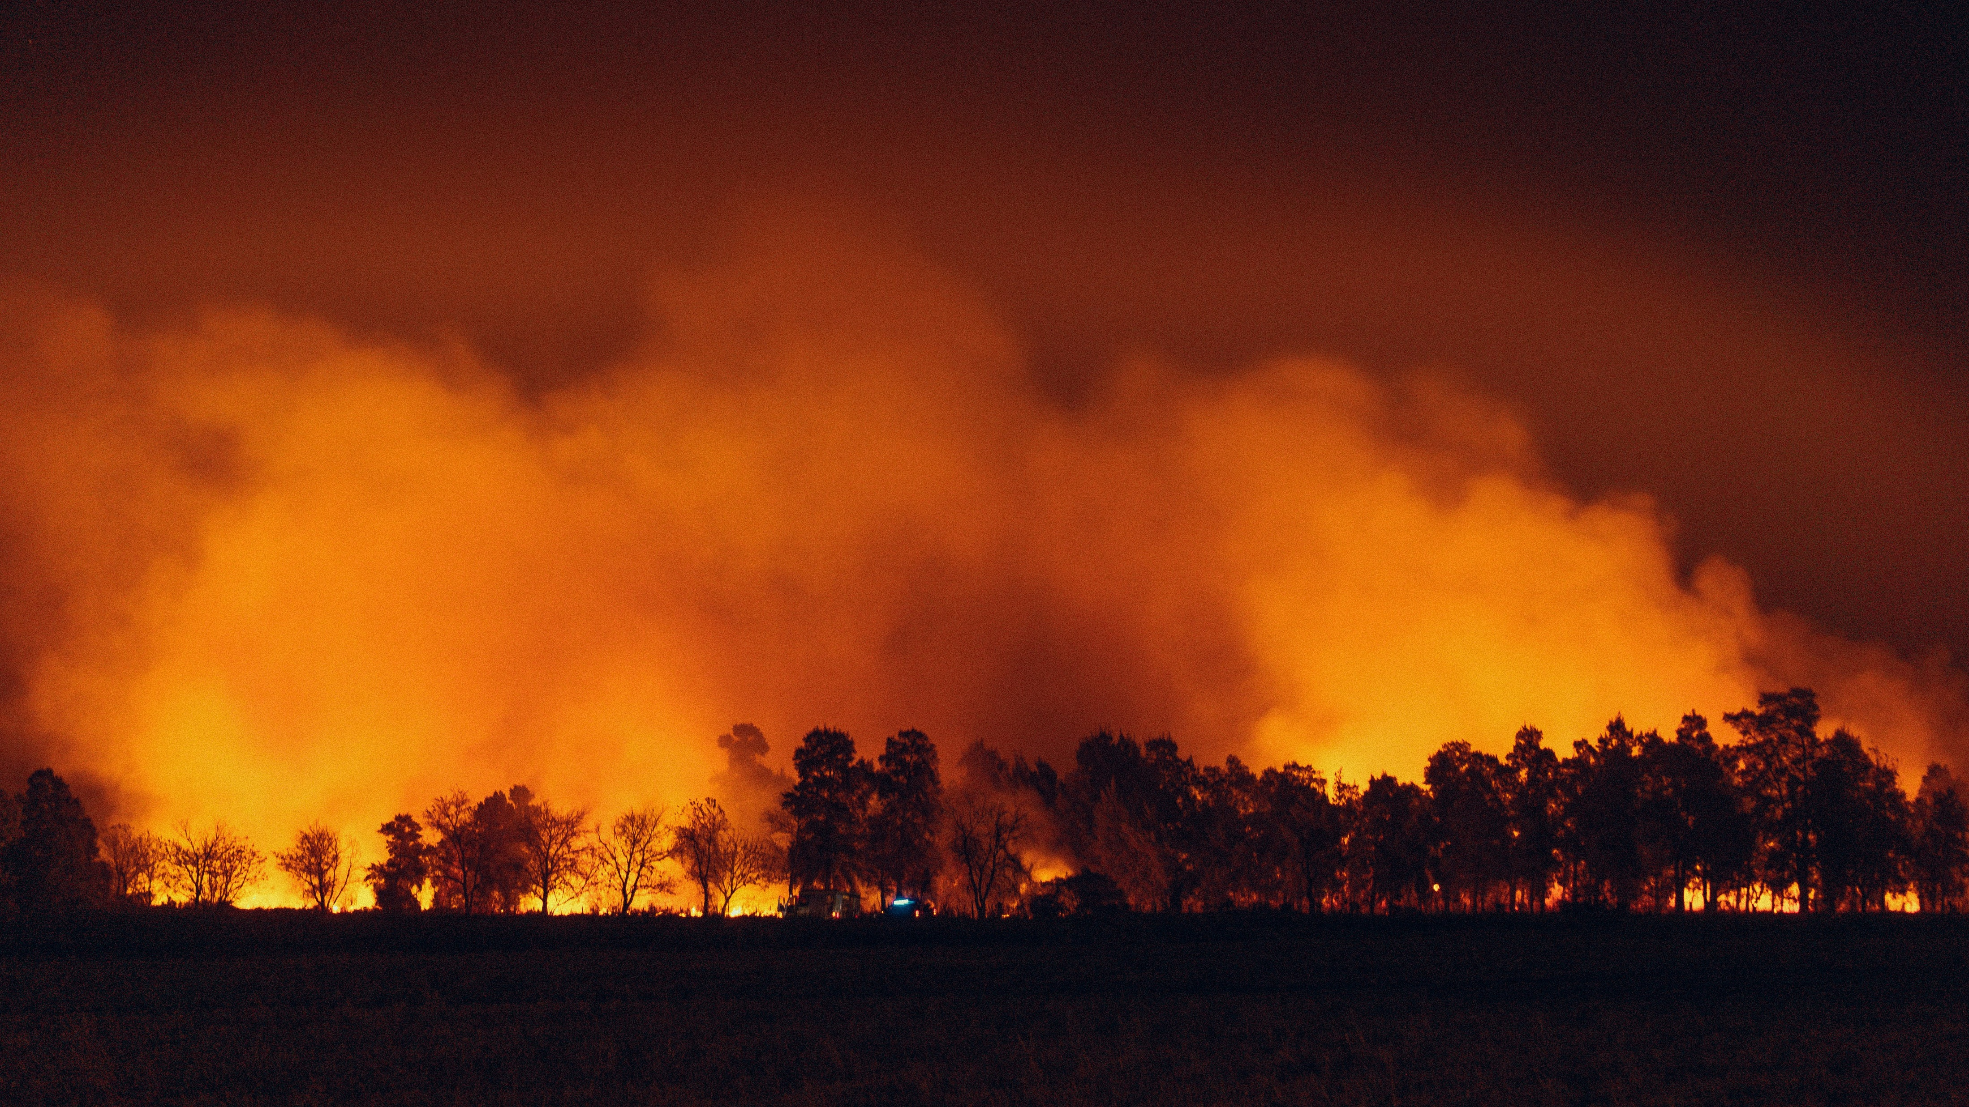


Analysis of Extreme Weather and Climate Events Impacts on Key Community Health and Economic Attributes
WORKING DRAFT
2024 AI BOOTCAMP | MODULE 10 GROUP PROJECT
Contributors: Jamie Bond, Mike Szumski, Rajesh Velamala

Slide 2
CONTENTS |  | PAGE
Executive Summary |  | 3
Project Overview |  | 5
Data Exploration |  | 6
Project Approach |  | 13
Additional Questions |  | 14
Results and Conclusion |  | 15
Reference Content |  | 16
PROJECT OBJECTIVE
In this project, the University of North Carolina Charlotte / Chapel Hill AI Bootcamp project team conducted a data analysis to examine the impacts of extreme weather and climate events on public health and local economy, with a particular emphasis on extreme heat and impacts to North Carolina.

Slide 3
EXECUTIVE SUMMARY
An executive summary or overview of the project and project goals (5 points)
DATA TRANSFORMATION AND ANALYSIS
Using Python tools and libraries, the investigating team conducted the following key activities:
Data Identification and Exploration – identified and reviewed available datasets, screening for data applicability and data quality
Data Transformation – imported, cleaned and joined datasets by location and date attributes or disaster ID
Data Analysis – explored the relationship of the various datasets using
pandas to investigation data correlation and dimensionality
numpy and pandas to analyze [XXX ]
scipy to perform [statistical analysis]
phophet to explore [time series forecasts]
KEY FINDINGS
After examining XXX, data analysis revealed XXX ..
PROJECT OBJECTIVE
To examine the impacts of extreme weather and climate events on public health and local economy, with a particular emphasis on extreme heat and impacts to North Carolina
DATA SOURCES
The investigating team narrowed its efforts on the collection, transformation, analysis and visualization of daily, county-level data (where available) for the five-year period between 2018 - 2022, focusing on the relationship between extreme events and the following:
FEMA Data: Nationally declared disasters by time period and location
US SBA Data: Disaster Loan Program assistance issued by location and disaster
CDC Data: Hospitalization and mortalities by time period and location

Slide 4
EXECUTIVE SUMMARY – con’t
An executive summary or overview of the project and project goals (5 points)
DataViz Placeholder
DataViz Placeholder
DataViz Placeholder
DataViz Placeholder
CONCLUSION
The data suggest …

Slide 5




OVERVIEW
DATA
REQUIREMENTS
Datatype: time-based, location-based
Min scale: 5 years (to include 2018-2022)
Min resolution: county-level
Content: economic, health-related
Across the US, major weather and climate events appear to be occurring more frequently and with greater intensity.
Consequently, we expected to find observable impacts to the health, safety and economic data reported across the country and sought to identify various datasets to investigate this hypothesis.
DATA EXPLORATION
Sources: FEMA, CDC, NCEMS, SBA
Screening: data resolution, level of completeness, ease of accessibility, data available attributes
DATA TRANS-FORMATION
Import: dataset download, API calls
Cleanup: NA/null removal, attribute selection, key identification (for joining data)
Combine:
Specifically, our aimed was to examine the impacts of extreme weather and climate events on public health and local economy using data analysis.
DATA ANALYSIS
Notes:
PROJECT OBJECTIVE
To examine the impacts of extreme weather and climate events on public health and local economy, with a particular emphasis on extreme heat and impacts to North Carolina
PROJECT OBJECTIVE
In this project, the University of North Carolina Charlotte / Chapel Hill AI Bootcamp project team conducted a data analysis to examine the impacts of extreme weather and climate events on public health and local economy, with a particular emphasis on extreme heat and impacts to North Carolina.

Slide 6
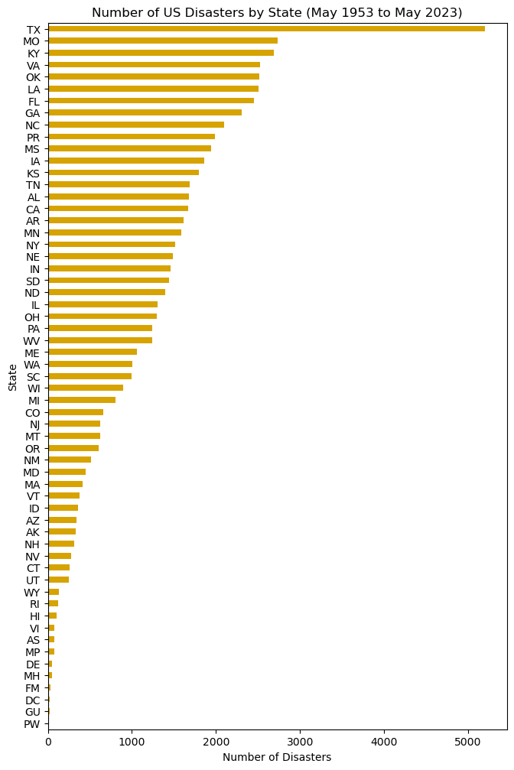
DATA EXPLORATION (Dataset 1)
1
DATASET DESCRIPTION
FEMA Disaster Declaration Summaries
65,158 total records
25 data attributes, including
State
County
Disaster ID
Declaration name
Declaration date
Declaration type
Collection via iterative API calls
(7 API calls due to 10,000 per call limit)
Data resolution
State and county level
70 years by declaration date
Texas is a clear outlier
(likely due to land area and gulf coast proximity
Data Profiling Activities
Viewed column headers (.columns)
Datatypes and non-null counts (.info)
Listed unique states represented
Confirmed first/last datetime values
Data Aggregation Activities
Record count by state
Record count by disaster ID no.
Record count by state and disaster date
Key Data Profiling Activities
Viewed column headers (.columns)
Datatypes and non-null counts (.info)
Listed unique states represented
Confirmed first/last datetime values
Key Data Aggregation Activities
Record count by state
Record count by disaster ID no.
Record count by state and disaster date
Notes:
Pull in hurricane harvey

Slide 7
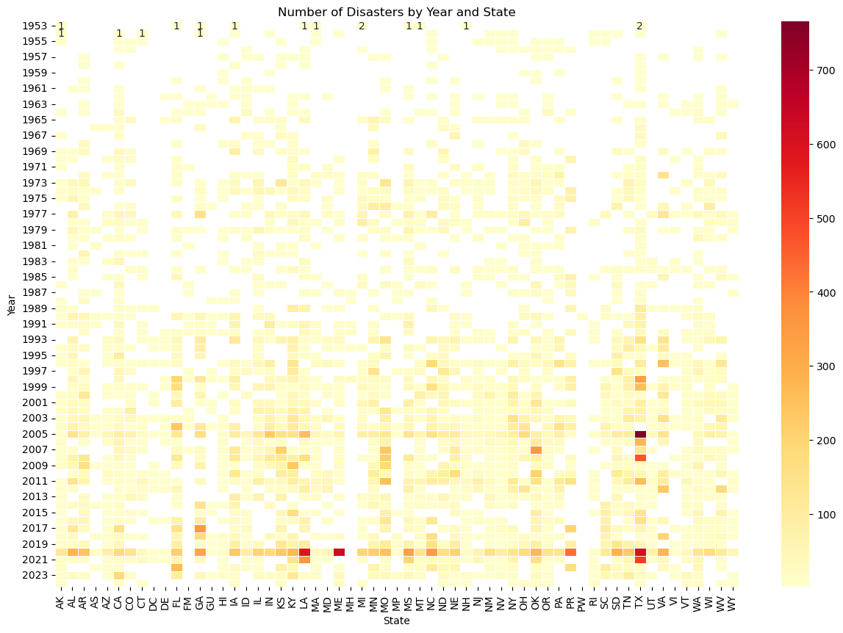
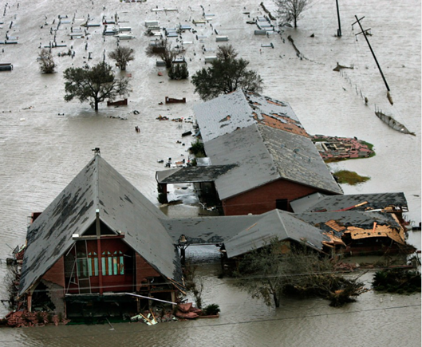
DATA EXPLORATION (Dataset 1)
Heatmap by state and number of disasters shows increasing frequency of disasters over time.
TX communities devastated by Hurricane Rita
Hurricane Katrina
SOURCE: PBS
COVID-19
Notes:
Pull in hurricane

Slide 8
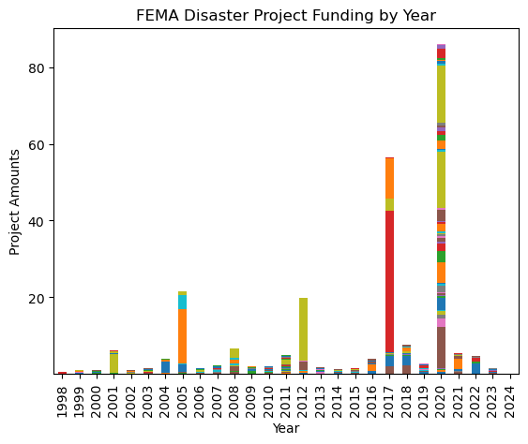
DATA EXPLORATION (Dataset 2)
DATASET DESCRIPTION
FEMA Public Assistance Funded Project Details
790406 total records
22 data attributes, including
State
County
Disaster ID
Declaration name
Declaration year
Incident type
Damage category
Project amount
Project size
Collection via iterative API calls
(80 API calls due to 10,000/call limit)
Data resolution
State-level (county data missing)
70 years by declaration date
Final Dataframe: 792,938 x 14
Key Data Profiling Activities
Viewed column headers (.columns)
Datatypes and non-null counts (.info)
Viewed unique years and states
Key Data Cleaning Activities
Dropped non-material columns
Dropped County columns (high N/A count
Converted Project Amount to billion USD
Key Data Aggregation Activities
Record count by state
Record count by disaster ID no.
Record count by state and disaster date
Historic response to COVID-19
Major funding allocated for Hurricane Harvey recovery in TX
Notes:
Pull in hurricane harvey

Slide 9
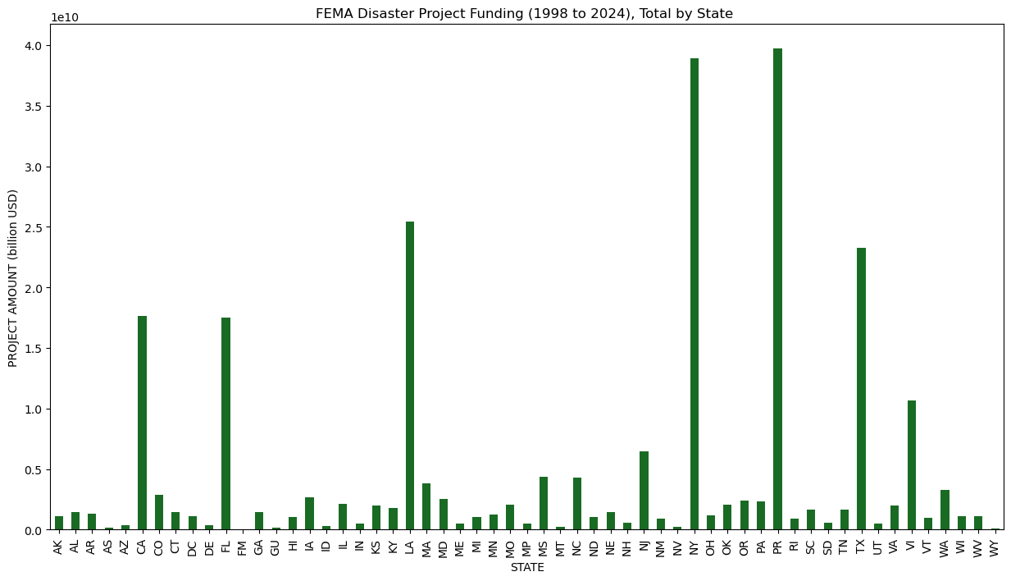
DATA EXPLORATION (Dataset 2)
Observation 2
Observation 1
[Heatmap by state and number of disasters shows increasing frequency of disasters over time.]
Notes:
Pull in hurricane

Slide 10
DATA EXPLORATION (Dataset 3)
DATASET DESCRIPTION
Center for Disease Control
790406 total records
22 data attributes, including
State
County
Disaster ID
Declaration name
Declaration year
Incident type
Damage category
Project amount
Project size
Collection via iterative API calls
(80 API calls due to 10,000/call limit)
Data resolution
State-level (county data missing)
70 years by declaration date
Final Dataframe: 792,938 x 14
Key Data Profiling Activities
Viewed column headers (.columns)
Datatypes and non-null counts (.info)
Viewed unique years and states
Key Data Cleaning Activities
Dropped non-material columns
Dropped County columns due to high N/A count
Converted Project Amount to billion USD
Key Data Aggregation Activities
Record count by state
Record count by disaster ID no.
Record count by state and disaster date
CDC National Outbreak Public Data
Notes:
Pull in hurricane harvey

Slide 11
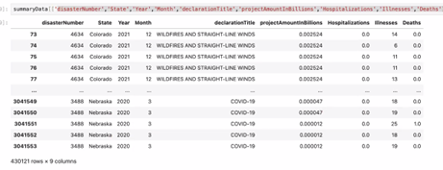
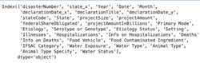
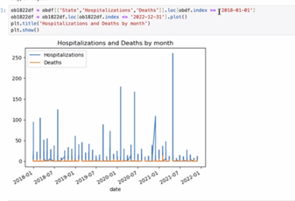
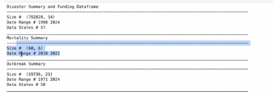
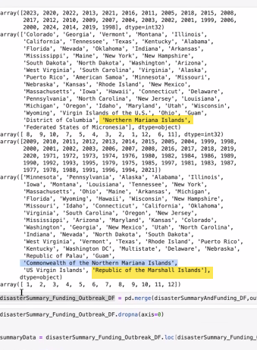
Data Exploration (CDC)
An overview of the data collection, cleanup, and exploration processes (5 points)
CDC Data: Hospitalization and mortalities by time period and location
Mortality – public health and safety impact
Could not use National Outbreaks – no county data (np PII_
Evaluated cataclysm event
Cause codes
Reviewed the data dictionary to understand -
Mortality has not location data so used outbreak data
Joined on year month and state
Notes:
DATA SOURCES
The investigating team narrowed its efforts on the collection, transformation, analysis and visualization of daily, county-level data (where available) for the five-year period between 2018 - 2022, focusing on the relationship between extreme events and the following:
FEMA Data: Nationally declared disasters by time period and location
US SBA Data: Disaster Loan Program assistance issued by location and disaster
CDC Data: Hospitalization and mortalities by time period and location
Considering lagging month to capture

Slide 12
DATA EXPLORATION (Dataset 4)
DATASET DESCRIPTION
Center for Disease Control
790406 total records
22 data attributes, including
State
County
Disaster ID
Declaration name
Declaration year
Incident type
Damage category
Project amount
Project size
Collection via iterative API calls
(80 API calls due to 10,000/call limit)
Data resolution
State-level (county data missing)
70 years by declaration date
Final Dataframe: 792,938 x 14
Key Data Profiling Activities
Viewed column headers (.columns)
Datatypes and non-null counts (.info)
Viewed unique years and states
Key Data Cleaning Activities
Dropped non-material columns
Dropped County columns due to high N/A count
Converted Project Amount to billion USD
Key Data Aggregation Activities
Record count by state
Record count by disaster ID no.
Record count by state and disaster date
CDC 5-year Mortality Data (can discuss why we didn’t use) after exploration
Notes:
Pull in hurricane harvey

Slide 13
Project Approach
The approach that your group took in achieving the project goals (5 points)
We may be able to weave this in the content above or on last page (contributions/roles) and drop this slide
Notes:
DATA TRANSFORMATION AND ANALYSIS
Using Python tools and libraries, the investigating team conducted the following key activities:
Data Identification and Exploration – identified and reviewed available datasets, screening for data applicability and data quality
Data Transformation – imported, cleaned and joined datasets by location and date attributes or disaster ID
Data Analysis – explored the relationship of the various datasets using
pandas to investigation data correlation and dimensionality
numpy and pandas to analyze [XXX ]
scipy to perform [statistical analysis]
phophet to explore [time series forecasts]

Slide 14
ADDITIONAL INVESTIGATION AREAS
Any additional questions that surfaced, what your group might research next if more time was available, or share a plan for future development (5 points)
Given additional time to locate, explore and transform additional dataset, the investigating team would like to have explored additional question and relationships.
DATA TO EXPLORE
Evaluation of state-level disaster data normalized by land area and per capita
Relationship between extreme heat events (historically excluded from disaster declarations) on mortality and agricultural and productivity losses
Relationship between major flood events and prevalence of mosquito born illnesses
Mike/Rajesh – feel free to add to the list (or drop in messages for me to add)

Slide 15
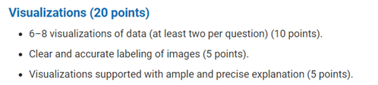
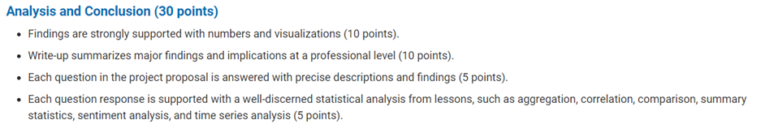
Results and Conclusion
The results and conclusions of the application or analysis (5 points)
Conclusions to be documented

Slide 16
Reference Content
GitHub
Project Repository: github.com/mikeszumski/Project_One_Repo
Contributors
Jamie Bond | @JBondAI
Michael Szumski | @mikeszumski
Rajesh Velamala | @REJESHVELAMALA
Data Providers
Federal Emergency Management Agency (FEMA)
US Small Business Administration
Center for Disease Control
North Carolina Department of Public Safety
Notes:
Disaster Information Dataset ( API Integration) - 2018 - 2022 https://www.fema.gov/data-visualization/disaster-declarations-states-and-counties - Rajesh API Documentation # https://www.fema.gov/about/openfema/api
Disaster Declaration Dataset https://lending.sba.gov/search-disaster/ - Jamie
Disaster Loan Data - Jamie https://data.sba.gov/dataset/e243640a-ed1c-4941-850e-b2c6aa15cad3/resource/dfca7ddd[…]a1-bb89-98fae0e6ff3a/download/sba_disaster_loan_data_fy22.xlsx
NC Disaster https://www.ncdps.gov/emergency-management/past-disasters
CDC- Mike https://data.cdc.gov https://wonder.cdc.gov/nndss/nndss_weekly_tables_menu.asp
https://www.fema.gov/openfema-data-page/public-assistance-funded-projects-details-v1
https://www.ncei.noaa.gov/access/billions/events/US/1980-2024?disasters[]=all-disasters
https://wwwn.cdc.gov/norsdashboard/
ttps://www.cdc.gov/nchs/nvss/mortality_public_use_data.htm

